Slide 1
SUBSCRIBE
Visit YouTube

Slide 2
Instructions Create a web page with a black background , a subscribe button and a link to YouTube
SUBSCRIBE
Visit YouTube

Slide 3
Elements Block elements inline Elements margin-left:100px; margin-right:100px; margin-top:20px; margin-bottom:20px: margin : 20px 100px;
Block element
Inline element
Inline element
SUBSCRIBE
Visit YouTube

Slide 4

SLIDES FOR THEORY LECTURES
Instructor
JB Webdeveloper
BUILD RESPONSIVE REAL – WORLD WEBSITES WITH HTML,CSS & JS (FRONTEND)
(DON’T SKIP THEM, THEY ARE SUPER IMPORTANT 😁)

Slide 5
SOME QUICK CONSIDERATIONS BEFORE WE START
It’s 100% normal that you will not understand everything at the beginning. Just don’t think “I guess coding is not for me”!
………………………………
If you want the course material to stick, take notes. Notes on code syntax, notes on theory concepts, notes on everything!
………………………………
Try all the coding challenges! Try to do your best, but if you get stuck for too long, watch the solution. Don’t beat yourself up if you can’t figure it out! Just rewatch the lectures that were covered in the challenge, try to understand them better, and move on.
………………………………..
Before moving on from a section, make sure that you understand exactly what was covered. Take a break, review the code we wrote, review your notes, review the projects we built, and maybe even write some code yourself.
……………………………….
Most importantly, have fun! It’s so rewarding to see something that YOU have built YOURSELF! So if you’re feeling frustrated, Let me Know so that we pause abit, and come back later!.

Slide 6
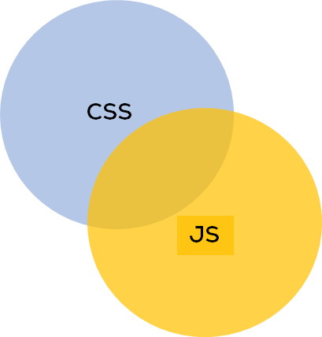
HTML FUNDAMENTALS
Its one of the three Core Technologies
That make up frontend
HTML
HTML, is the backbone of the web

Slide 7
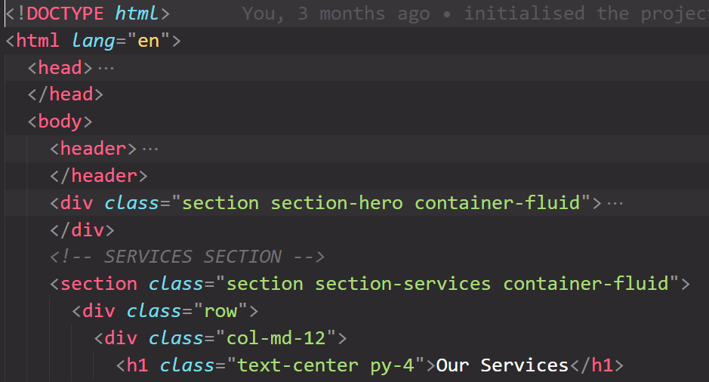

What is HTML? -- summary
Its one of the three Core Technologies
That make up frontend
HTML
✔ HyperText Markup Language
HTML
✔ HTML is a markup language that web developers use to structure and describe the content of a webpage (not a programming language)
✔ HTML consists of elements that describe different types of content: paragraphs, links, headings, images, video, etc.
✔ Web browsers understand HTML and render HTML code as websites

Slide 8
Understanding an HTML Element
Element
<p> HTML is a markup language </p>
Content: Content of the element, in
this example text. But it might be
another element (child element). Some
elements have no content (e.g. <img>)
Closing tag: Same as
opening tag, but with
a /. When element has
no content, it’s omitted
Opening tag: Name of the element, wrapped in < and >

Slide 9
Structure of an HTML Document
HTML Document
HEAD
BODY
This contains the information about the HTML document. For Example, the Title of the page, version of HTML, Meta Data , links, etc.
This contains everything you want to display on the Web Page.
This part of HTML is NOT visible on the page

Slide 10
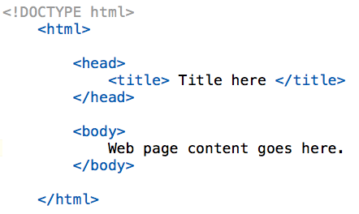
Structure of an HTML Document
HEAD
HTML Document
BODY

Slide 11
Structure of an HTML Document
The DOCTYPE tells the web browser which version of HTML the page is written in. This currently tells that the version is HTML 5.0
element tells the browser that the page will be formatted in HTML.
<html> tag is parent tag of <head> and <body> tag.
HEAD
HTML Document
BODY

Slide 12
CSS FUNDAMENTALS
CSS describes the visual style and presentation of the content
written in HTML
HTML
CSS
CSS, is used to style the content

Slide 13
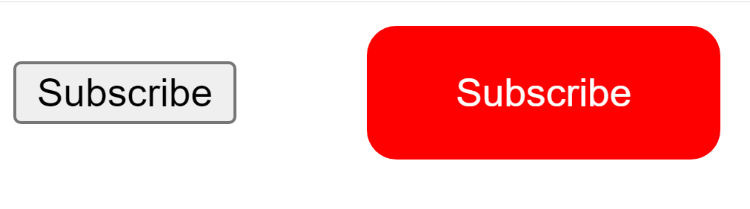
What is CSS? -- summary
CSS
✔ Cascading Style Sheets
✔ CSS describes the visual style and presentation of the content
written in HTML
✔ CSS consists of countless properties that developers use to format
the content: properties about font, text, spacing, layout, etc
HTML Button
Without CSS
HTML Button
With CSS

Slide 14
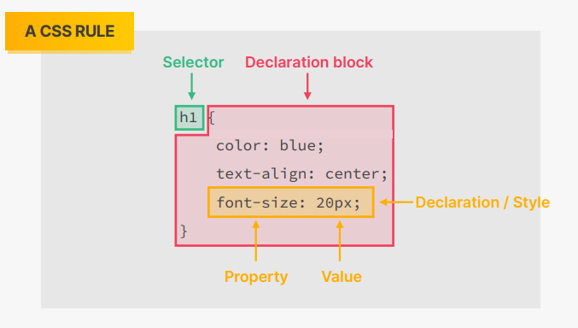
HOW WE SELECT AND STYLE ELEMENTS

Slide 15
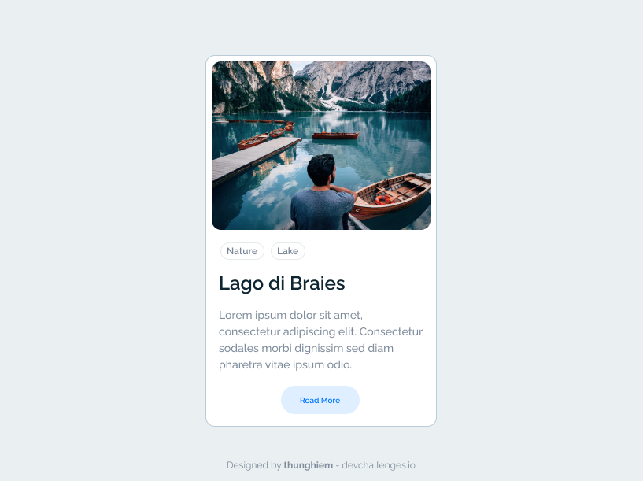
EXERCISE 1.1: Profile Card

Slide 16

EXERCISE 1.2: Product Card

